Slide 1


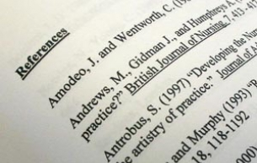
Referencing for Academic Success IMAT1610
Beverley Hancock-Smith
Centre for Learning and Study Support (CLaSS) Enhancing academic practice, writing development and professional skills
Notes:
Give out Annie’s Quiz.

Slide 2

Already covered by your workshop session:
Finding a range of academic resources
Referencing
in text citation
reference list

Slide 3

What do you hope to learn?
Notes:
Academic writing is based on traceable evidence
Consistent system
3 reasons: To say thanks you., to be academic…use evidence, to be traceable….your reader can look up the sources.

Slide 4

In this session we will think about …
Why we reference
Direct and indirect quotations and how to use them effectively
Paraphrasing ideas and how to do it effectively

Slide 5
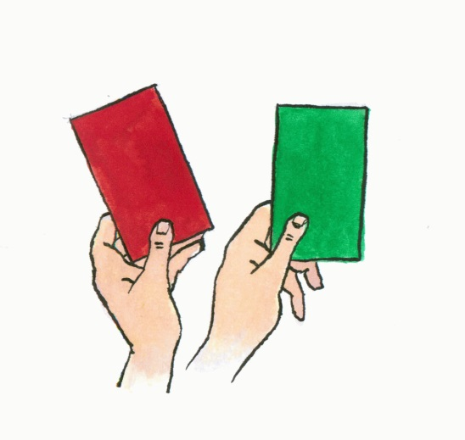
Activity 1
Good Academic Practice
Bad Academic Practice
Notes:
Academic writing is based on traceable evidence
Consistent system
3 reasons: To say thanks you., to be academic…use evidence, to be traceable….your reader can look up the sources.

Slide 6
Task: Identify good and bad practice
Read / listen to the following 8 examples and decide which is:
Good practice = Green
Bad practice = Red
Questionable = Both

Slide 7
Direct and indirect quotations and paraphrasing
How to quote directly from evidence

Slide 8

What is a direct quotation?

Slide 9

Direct quotation
A direct quotation is a report of the exact words of an author or speaker.
A direct quotation is placed inside quotation marks.
For example, Dr King said, ‘I have a dream.’

Slide 10

What is an indirect quotation?

Slide 11
Indirect Quotations
An indirect quotation is a paraphrase of someone else's words: it reports on what a person said without using the exact words of the speaker.
An indirect quotation is not placed in quotation marks.
For example: Dr King said that he had a dream.

Slide 12
Single or double?
The use of quotation marks, also called inverted commas, is very slightly complicated by the fact that there are two types:
single quotes (` ') and
double quotes (" ").
As a general rule, British usage has in the past usually preferred single quotes for ordinary use, but double quotes are now increasingly common.

Slide 13

Spot the indirect quotation

Slide 14
Direct and Indirect Quotations
Rogers and Green (2008) argue that ‘the family home has the greatest impact on educational development’.
As Rogers and Green (2008) points out, ‘the family home has the greatest impact on educational development’.
A child’s educational progress is most influenced by their home life (Rogers and Green, 2008).
According to Rogers and Green (2008), ‘the family home has the greatest impact on educational development’.
In their paper , ‘Child Development’ (2008), Rogers and Green state that ‘the family home has the greatest impact on educational development’.

Slide 15

How to use your quotations effectively

Slide 16
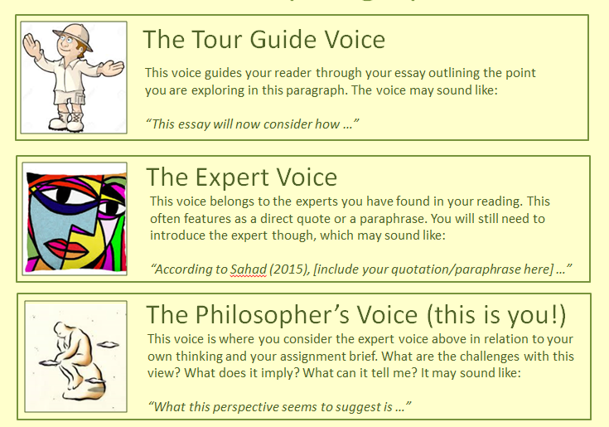
Your writing will have layers of voices
Notes:
Writing activity

Slide 17



The concept of class is often considered using the proxy of economic status. The following paragraph will examine a number of economic measures and assess how useful they are in relation to the assignment question.
Diemer et al. (2013) state that income is often measured by assessing total family income. They discuss that salary ranges are used to overcome participant’s reluctance to provide detailed accounts of what is often considered to be a private matter. Family wealth measurement is generally measured by calculating a family’s assets such as stocks, equity, savings etc, and taking away family debt (Diemer et al, 2013). They also suggest that such data can be highly volatile from year to year. Diemer and Ali (2009) discuss that familial wealth could provide a more comprehensive measurement of resources than household income and therefore is a more accurate measure of access to economic resources.
According to the evidence outlined above, there appears to be a number of issues with the use of finances as a proxy for social class. Firstly the decision to use income or wealth presents some problems. The question can be asked does the measure of a person’s income at one moment in time really provide an insight into their social class? It could be argued that using a measure of personal wealth allows a more longitudinal view of a personal financial situation. However either measure could be seen as problematic as the data is highly volatile and susceptible to year by year fluctuations, in contrast to this, class is usually seen as a much more stable concept.

Slide 18

A step-by-step guide to: Paraphrasing

Slide 19
1. Paraphrasing: Using synonyms
Companies that show a genuine interest in charitable activities can earn the respect of the buying public (Soller, 2010).
Businesses that demonstrate a real interest in non-profit making activities can gain the respect of consumers. (Soller, 2010).
Now you try:
The two charities worked tirelessly against the damaging effects of child labour.
Notes:
When do we use paraphrasing?
As an alternative to direct quotations
To show that you understand the original text
Can use a dictionary to help with this.
When you are synthesising ideas. As discussed by Brown, Jones, Smith etc

Slide 20
2. Paraphrasing: Changing the grammatical structure
Persuading the public to sign up to monthly donations is a more cost-effective policy than collecting single contributions (Polson, 2009).
Collecting single contributions is not as cost-effective as persuading the public to sign up to monthly donations, according to Polson (2009)
Now you try:
Familiarity with local customs is essential for aid workers

Slide 21
3. Paraphrasing: Using both
Indirect delivery via institutions such as the World Bank may mean that UK charity contributions are lost to corrupt practices (Gates, 2008)
becomes…
Gates (2008) argues that UK charity contributions may be lost through corrupt practices if they are distributed by institutions such as the World Bank.
..which then becomes….
Gates (2008) argues that UK charity funds could disappear through corruption if they are distributed through organisations such as the World Bank.

Slide 22
Paraphrasing: Using both
Now you try:
Competition amongst charities has never been greater than it is at the moment (Briggs, 2011).

Slide 23
In this session we have examined:
Why we reference
Direct and indirect quotations and how to use them effectively
Paraphrasing ideas and how to do it effectively

Slide 24



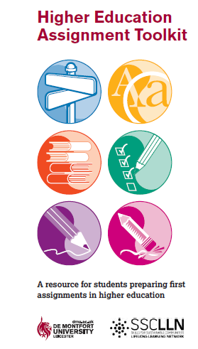
Centre for Learning and Study Support Enhancing academic practice, writing development and professional skills
Tutorials and Drop-in
Workshops
Workshops run every two weeks: Keep an eye out on blackboard and MyDMU to see our upcoming sessions
To sign up go the library what’s on page: www.library.dmu.ac.uk/Home/Calendar
Book a 30 minute one-to-one appointment to discuss any aspect of your study or work: visit the Library “What’s on?” page to book.
Just a quick question? Drop in every Monday, Wednesday, Friday, 2-3pm, Tuesday and Thursday 5-6pm in the LDZ Kimberlin library where CLaSS will be waiting to answer your question!
Guides
To view our online resources go to: www.library.dmu.ac.uk/link/CLASS
To help fit the pieces of your study together visit: www.library.dmu.ac.uk/link/CLASS

